Slide 1
Unit 4.5
Software Engineering
Dr. Loraine Annie

Slide 2
What is software?
Software is a set of instructions, data or programs used to operate computers and execute specific tasks.
Computer programs and associated documentation such as requirements, design models and user manuals.
Two types of Software
System software
Application software
Software products may be
Generic - developed to be sold to a range of different customers e.g. PC software Ex: Excel or Word.
customised - developed for a single customer according to their specification. Ex: Moodle
New software can be created by developing new programs, configuring generic software systems or reusing existing software.

Slide 3
Software Engineering: Definition
Software engineering is a detailed study of engineering that is concerned with the design, development and maintenance of software.
Software Engineering is a collection of
methodologies and tools that help
with the production of
a high quality software system
with a given budget
before a given deadline
while change occurs.
The study and application of methodologies to develop quality software that fulfill customer needs.
20

Slide 4
What is software engineering?
The application of a systematic, disciplined, quantifiable approach to the development, operation, and maintenance of software, and the study of these approaches.
Software engineers should adopt a systematic and organised approach to their work and use appropriate tools and techniques depending on the problem to be solved, the development constraints and the resources available.

Slide 5
Software Engineering
Objective
To produce software that is:
On time: is deliver at the established date.
Reliable: doesn´t crash.
Complete: good documentation, fulfill customer needs.

Slide 6
What is the difference between software engineering and system engineering?
System engineering is concerned with all aspects of computer-based systems development including hardware, software and process engineering. Software engineering is part of this process concerned with developing the software infrastructure, control, applications and databases in the system.
System engineers are involved in system specification, architectural design, integration and deployment.

Slide 7
Software engineering
The economies of ALL developed nations are dependent on software.
More and more systems are software controlled
Software engineering is concerned with theories, methods and tools for professional software development.
Expenditure on software represents a significant fraction of GNP in all developed countries.

Slide 8

The team

Slide 9
Stages for software development
Requirements Analysis
Software Design
Implementation
Testing
Maintenance

Slide 10
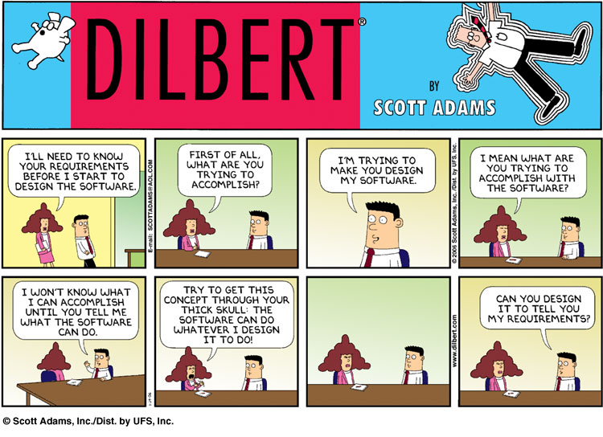
1. Requirements Analysis
Find out what the client want the software to do

Slide 11
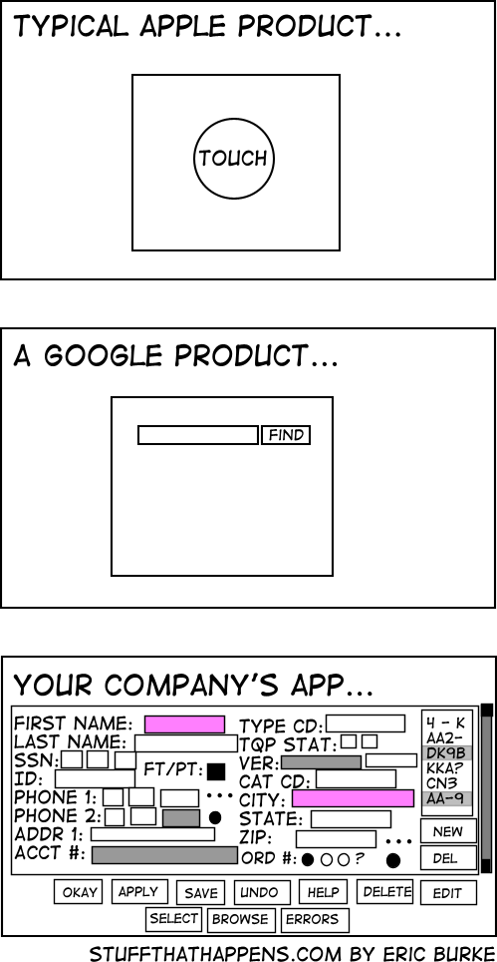
2. Design
Planning the software solution

Slide 12
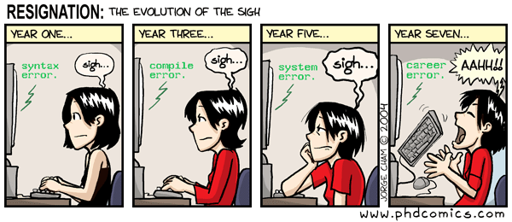
3. Implementation
Code!!!

Slide 13
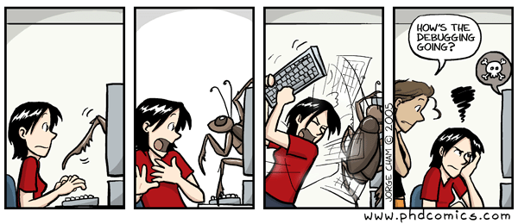
4. Testing
Executing the application trying to find software bugs

Slide 14
5. Maintenance
Any activity oriented to change an existing software product.

Slide 15
What are the attributes of good software?
The software should deliver the required functionality and performance to the user and should be maintainable, dependable and acceptable.
Acceptability
Software must be accepted by the users for which it was designed. This means it must be understandable, usable and compatible with other systems.
Maintainability
Software must evolve to meet changing needs;
Dependability
Software must be trustworthy;
Efficiency
Software should not make wasteful use of system resources;

Slide 16
What are the key challenges facing software engineering?
Heterogeneity
Developing techniques for building software that can cope with heterogeneous platforms and execution environments;
Delivery
Developing techniques that lead to faster delivery of software;
Trust
Developing techniques that demonstrate that software can be trusted by its users.

Slide 17
Software costs
Software costs often dominate computer system costs. The costs of software on a PC are often greater than the hardware cost.
Software costs more to maintain than it does to develop. For systems with a long life, maintenance costs may be several times development costs.
Software engineering is concerned with cost-effective software development.

Slide 18
What are the costs of software engineering?
Roughly 60% of costs are development costs, 40% are testing costs. For custom software, evolution costs often exceed development costs.
Costs vary depending on the type of system being developed and the requirements of system attributes such as performance and system reliability.
Distribution of costs depends on the development model that is used.

Slide 19
What is a software process?
A set of activities whose goal is the development or evolution of software.
Generic activities in all software processes are:
Specification - what the system should do and its development constraints
Development - production of the software system
Validation - checking that the software is what the customer wants
Evolution - changing the software in response to changing demands.

Slide 20
What is a software process model?
A simplified representation of a software process, presented from a specific perspective.
Examples of process perspectives are
Workflow perspective - sequence of activities;
Data-flow perspective - information flow;
Role/action perspective - who does what.
Generic process models
Waterfall;
Iterative development

Slide 21
Activity cost distribution

Slide 22
What is CASE (Computer-Aided Software Engineering)
Software systems that are intended to provide automated support for software process activities.
CASE systems are often used for method support.
Upper-CASE
Tools to support the early process activities of requirements and design;
Lower-CASE
Tools to support later activities such as programming, debugging and testing.

Slide 23
Professional and ethical responsibility
Software engineering involves wider responsibilities than simply the application of technical skills.
Software engineers must behave in an honest and ethically responsible way if they are to be respected as professionals.
Ethical behaviour is more than simply upholding the law.

Slide 24
Issues of professional responsibility
Confidentiality
Engineers should normally respect the confidentiality of their employers or clients irrespective of whether or not a formal confidentiality agreement has been signed.
Competence
Engineers should not misrepresent their level of competence. They should not knowingly accept work which is outwith their competence.

Slide 25
Issues of professional responsibility
Intellectual property rights
Engineers should be aware of local laws governing the use of intellectual property such as patents, copyright, etc. They should be careful to ensure that the intellectual property of employers and clients is protected.
Computer misuse
Software engineers should not use their technical skills to misuse other people’s computers. Computer misuse ranges from relatively trivial (game playing on an employer’s machine, say) to extremely serious (dissemination of viruses).

Slide 26
Code of Ethics
The Code contains eight Principles related to the behaviour of and decisions made by professional software engineers, including practitioners, educators, managers, supervisors and policy makers, as well as trainees and students of the profession.

Slide 27
Code of ethics - preamble
Preamble
The short version of the code summarizes aspirations at a high level of the abstraction; the clauses that are included in the full version give examples and details of how these aspirations change the way we act as software engineering professionals. Without the aspirations, the details can become legalistic and tedious; without the details, the aspirations can become high sounding but empty; together, the aspirations and the details form a cohesive code.
Software engineers shall commit themselves to making the analysis, specification, design, development, testing and maintenance of software a beneficial and respected profession. In accordance with their commitment to the health, safety and welfare of the public, software engineers shall adhere to the following Eight Principles:

Slide 28
Code of ethics - principles
PUBLIC
Software engineers shall act consistently with the public interest.
CLIENT AND EMPLOYER
Software engineers shall act in a manner that is in the best interests of their client and employer consistent with the public interest.
PRODUCT
Software engineers shall ensure that their products and related modifications meet the highest professional standards possible.

Slide 29
Code of ethics - principles
JUDGMENT
Software engineers shall maintain integrity and independence in their professional judgment.
MANAGEMENT
Software engineering managers and leaders shall subscribe to and promote an ethical approach to the management of software development and maintenance.
PROFESSION
Software engineers shall advance the integrity and reputation of the profession consistent with the public interest.

Slide 30
Code of ethics - principles
COLLEAGUES
Software engineers shall be fair to and supportive of their colleagues.
SELF
Software engineers shall participate in lifelong learning regarding the practice of their profession and shall promote an ethical approach to the practice of the profession.

